Slide 1

Rental Car Cancellation Predictor
Michael Engeling
Notes:
Hi I’m Michael Engeling. I’m a data scientist with an economics and finance background. When it came time to decide on a final project for this course, I went to Silvercar, which is an Austin-based rental car startup I interned for, to see if they had any data I could use. They were kind enough to give me a lot of their data, so I decided to create a model that would predict when their reservations would be cancelled

Slide 2
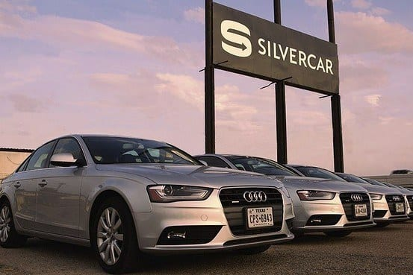
Project Motivation
Silvercar doesn’t charge customers for cancellations
Users can create reservations without creating an account or entering credit card info
Consequently, 41% of Silvercar’s reservations result in cancellations
Notes:
Now a little background on Silvercar, Silvercar aims to take the pain out of the car rental process

Slide 3
Objective
Predict when users will cancel reservations to help Silvercar:
Better manage their fleet of cars
Improve short-term revenue forecasts
Potentially identify opportunities to prevent cancellations
Results:
80% accuracy using a gradient boosting classifier
Notes:
I set out to create a model that’s accurate enough to give them a better idea of roughly how many rides would be cancelled at each location to:
Better manage their fleet of cars, so there aren’t as many cars sitting by idly
Improve revenue forecasting
Maybe identify opportunities to prevent cancellations
How did I achieve those results? Next slide

Slide 4







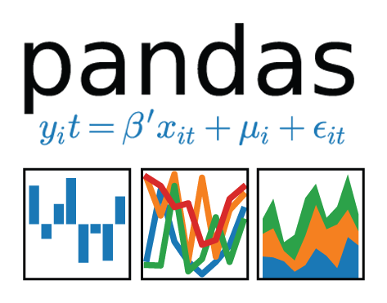



Technologies
Notes:
I used most of the standard data science tools, but I used XGBoost’s implementation of gradient boosting because it’s fast and performs well without much tuning

Slide 5
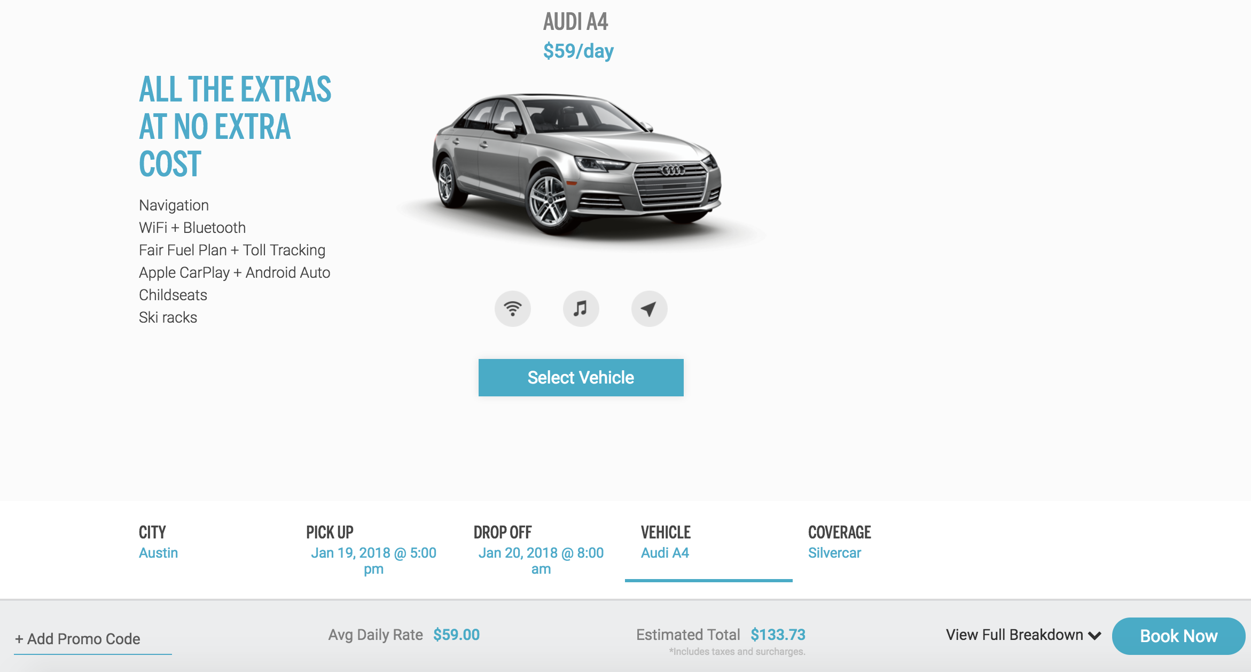
Data:
Reservations
Users
Promotions
Locations
Notes:
As for the data at my disposal, I had access to a number of different data sources that had information on the reservations, the users, promotions, and locations
Their reservation page is shown on the screen, and the red boxes indicate some of the available features of reservations that were used in the model

Slide 6
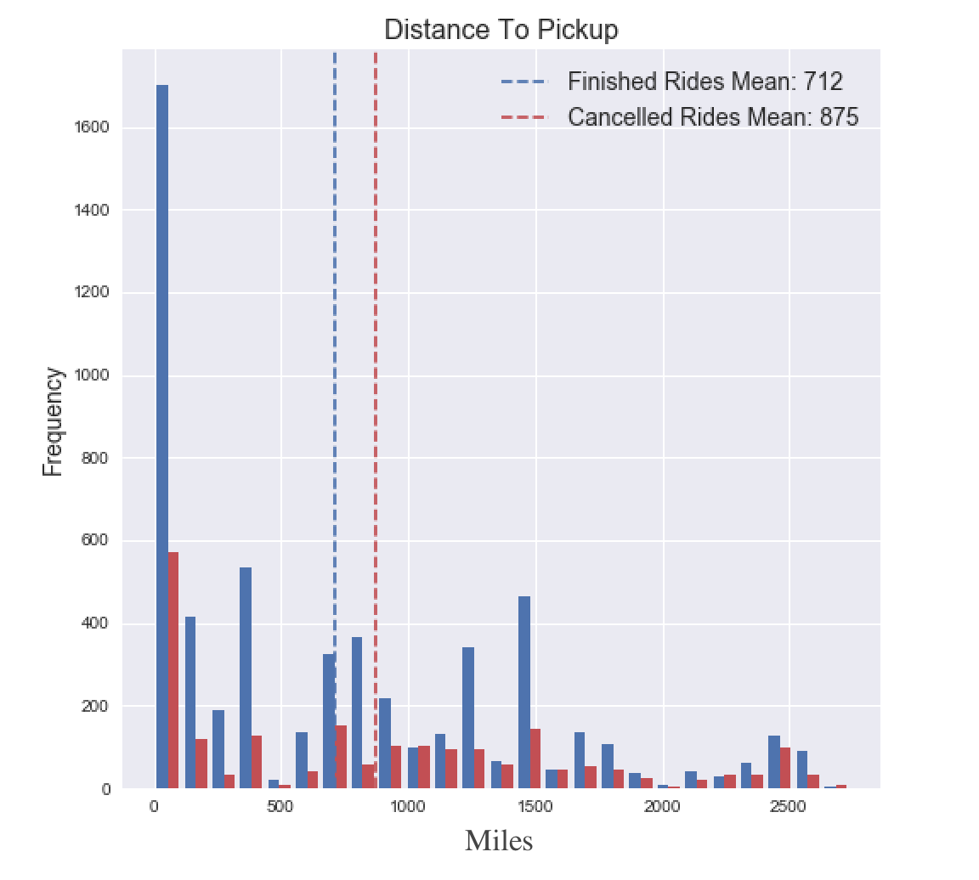
Challenges
Initial model was 95% accurate
Stripped out features that couldn’t be used in real model
Focused on features that would be available, such as distance travelled
Notes:
Started with 75% accurate model and then I did a lot of data analysis and created new features from existing ones
This gave me a 95% accurate model, which seemed a little too good because human behavior is inherently unpredictable
I couldn’t really use any of my user data because I was testing my model on past data that wouldn’t have been available when making predictions
On the screen are two histogram plots of features I had to remove
The first shows the distribution of the number of sign-ins and the second shows the distribution of the number of days since the users signed in
On average, finished rides have 140 more sign-ins and 115 less days since the user signed in

Slide 7
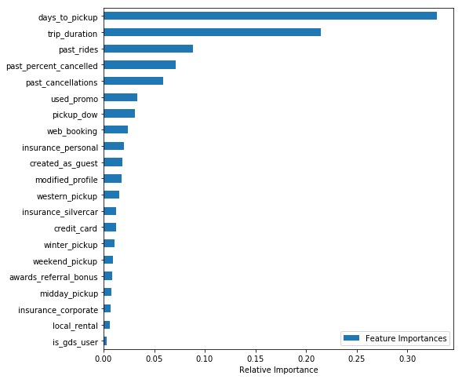
Feature Importances
Numerical:
Days to pickup
Trip duration
Past Rides
Percent of past rides cancelled
Categorical:
Used promo
Pickup day of week
Web booking
Insurance personal
Guest
Notes:
Cancelled, Finished
Days to pickup: 22, 15.5
Trip duration: 2.98, 2.77
Past rides: 4.5, 2.8
Percent of past rides cancelled: .45, .34
Past cancellations: 1.43, 1.03
Used promo: 0.26, 0.53
Pickup day of week: 3.04, 2.70
Web booking: .59, .44
Insurance personal: .37, .58
Guest: .31, .15
Modified profile: .75, .99
Western pickup: .180, .168
Insurance silvercar: .14, .10
Credit card: .61, .99
Winter pickup: .17, .14
Weekend pickup: 0.45, 0.36
Referral: 0.0, 0.05
Midday pickup: 0.06, 0.03
Insurance corporate: 0.04, 0.08
Local rental: 0.005, 0.043
GDS user: 0.056, 0

Slide 8
Future Improvements
Work with Silvercar to incorporate user data into the model
See if it’s possible to use historical user data
Look into different existing data sources
Investigate new ways to acquire user data
Notes:
Currently only using one user variable, GDS (global distribution system) user

Slide 9
Web Application
Live Demo

Slide 10



Questions? Contact Me
michael.engeling@gmail.com
linkedin.com/in/mengeling/
github.com/mengeling/Silvercar-Cancellation-Predictor

